Slide 1
Georgia Association of Zoning Administrators
February 5, 2015
ARE YOU READY TO GO TO COURT?
Presented by
Brandon L. Bowen,
with the assistance of Sun Tzu 孫子 (c. 6th century BCE)

Slide 2


Slide 3

There is no instance of a nation benefitting from prolonged warfare. - 孫子

Slide 4
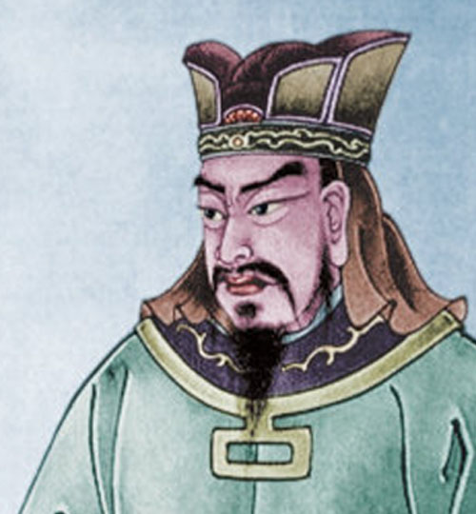
For to win one hundred victories in one hundred battles is not the acme of skill. The supreme art of war is to subdue the enemy without fighting. -
孫子

Slide 5
The general who wins the battle makes many calculations in his temple before the battle is fought. The general who loses makes but few calculations beforehand. 孫子

Slide 6
Civil Zoning Cases
Rezoning Cases (denied)
Rezoning Cases (granted)
Special Use Permits

Slide 7
4-Part Analysis
What is the ISSUE?
What is the STANDARD OF REVIEW?
What EVIDENCE should I present?
What DEFENSES should I anticipate?

Slide 8
What is the issue?
What has to be proved?

Slide 9

Thus, what is of supreme importance in war is to attack the enemy's strategy. 孫子

Slide 10
Rezoning Denied
Taking / Due Process / Equal Protection
Is the existing zoning a substantial detriment to the subject property?
Does the existing zoning substantially benefit the public welfare?

Slide 11
Rezoning Granted
Is the rezoning a manifest abuse of the zoning power?
Fraud?
Arbitrary and Capricious?

Slide 12
Special Use Permit
Whether granted or denied, what are the subjective and objective criteria of the ordinance?

Slide 13
Guhl Factors
(Guhl v. Holcomb Bridge Road Corp., 238 Ga. 322 (1977))
(1) Existing uses and zoning of nearby property;
(2) The extent to which property values are diminished by the particular zoning restrictions;
(3) The extent to which the destruction of property values of the plaintiffs promotes the health, safety, morals or general welfare of the public;

Slide 14
Guhl Factors
(4) The relative gain to the public, as compared to the hardship imposed upon the individual property owner;
(5) The suitability of the subject property for the zoned purposes; and
(6) The length of time the property has been vacant as zoned considered in the context of land development in the area in the vicinity of the property.

Slide 15
What is the standard of review?
How is the court going to view the evidence?
Who bears the burden of proof?

Slide 16

The expert in battle seeks his victory from strategic advantage and does not demand it from his men. 孫子

Slide 17
Rezoning Denied
De novo hearing (New evidence comes in)
Property owner bears the burden of showing that existing zoning is a significant burden.
If PO carries that burden, then local government bears the burden of showing that the significant burden is justified by the public benefit.

Slide 18
Rezoning Granted /
Neighbor challenge
De novo (new evidence comes in)
Neighbor bears the burden of showing manifest abuse of the zoning power.

Slide 19
Special Use Permit
Record review – NO new evidence!
Any evidence standard – is there any substantial evidence in the record that supports the decision?
Standard is deferential to the local government.

Slide 20
What evidence to present?

Slide 21

Victorious warriors win first and then go to war, while defeated warriors go to war first and then seek to win. 孫子

Slide 22
Rezoning Denied
The existing zoning is not a substantive detriment.
Existing Zoning is consistent with land use planning / FLUM
Existing Zoning is consistent with surrounding zoning – so be able to show the surrounding area.
Existing Zoning is consistent with actual uses in the area.
What uses could be made of the property as zoned?
Appraise the property and compare to acquisition price.

Slide 23
Rezoning Denied
Existing zoning supports the public benefit.
Impact of the rezoning on infrastructure.
Impact of the rezoning on property values.
Impact of the rezoning on traffic.
Nuisance concerns.
Impact of rezoning on consistent land use planning – would rezoning undermine future planning?

Slide 24
Rezoning Granted
Is the new zoning consistent with the future land use plan / comprehensive planning?
Is the new zoning consistent with the zoning of surrounding properties and the development trend?
Do the challengers have STANDING? (Should you raise this in your report?)

Slide 25
Special Use Permit
What Evidence is IN THE RECORD?
Does is track the Guhl Factors?
Does it support the criteria in the ordinance?
Planner’s analysis and recommendation are key.
Transcript of the public hearing.

Slide 26
What witnesses?
Planners
  Employed or Independent?
Appraiser
Other Developers – can talk about viable uses as zoned.
Engineers
  Traffic
  Environmental concerns
Real Estate Agents
Legislators?

Slide 27
Evidence in every case:
Certified copy of the ordinance.

Slide 28
What defenses can I expect?

Slide 29

It is said that if you know your enemies and know yourself, you will not be imperiled in a hundred battles; if you do not know your enemies but do know yourself, you will win one and lose one; if you do not know your enemies nor yourself, you will be imperiled in every single battle. 孫子

Slide 30
Notice and Procedure
Ordinance as a whole properly adopted.
Map properly adopted and provable.
Zoning Decision complies with ZPL
  - notice
  - public hearing
  - sign
Standards
Policies and Procedures

Slide 31
Spot zoning
Fringe Area Doctrine
Consistency with the FLUM / Comp plan

Slide 32
Selective Enforcement
Keep records of your zoning actions so that you can be prepared to address other cases that are arguably similar.

Slide 33
Highest and Best Use
Property would be worth more as rezoned.

Slide 34
 | Issue | Standard of review | Evidence
Rezoning denied | Taking / Due Process / Equal Protection Is the existing zoning a substantial detriment to the subject property? Does the existing zoning substantially benefit the public welfare? | De novo hearing (New evidence comes in) Property owner bears the burden of showing that existing zoning is a significant burden. If PO carries that burden, then local government bears the burden of showing that the significant burden is justified by the public benefit. | Existing Zoning is consistent with land use planning / FLUM Existing Zoning is consistent with surrounding zoning – so be able to show the surrounding area. Existing Zoning is consistent with actual uses in the area. What uses could be made of the property as zoned? Appraise the property and compare to acquisition price. Impact of the rezoning on infrastructure. Impact of the rezoning on property values. Impact of the rezoning on traffic. Nuisance concerns. Impact of rezoning on consistent land use planning – would rezoning undermine future planning?
Rezoning granted | Is the rezoning a manifest abuse of the zoning power? Fraud? Arbitrary and Capricious? | De novo (new evidence comes in) Neighbor bears the burden of showing manifest abuse of the zoning power. | Is the new zoning consistent with the future land use plan / comprehensive planning? Is the new zoning consistent with the zoning of surrounding properties and the development trend? Do the challengers have STANDING? (Should you raise this in your report?)
Special use permit | Whether granted or denied, what are the subjective and objective criteria of the ordinance? | Record review – NO new evidence! Any evidence standard – is there any substantial evidence in the record that supports the decision? Standard is deferential to the local government. | What Evidence is IN THE RECORD? Does is track the Guhl Factors? Does it support the criteria in the ordinance? Planner’s analysis and recommendation are key. Transcript of the public hearing.

Slide 35
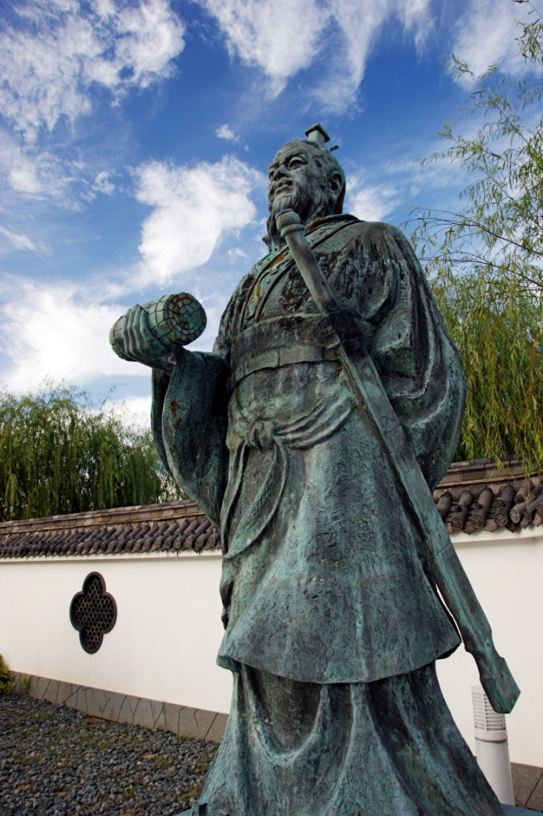
The general that hearkens to my counsel and acts upon it, will conquer: let such a one be retained in command! The general that hearkens not to my counsel nor acts upon it, will suffer defeat: — let such a one be dismissed! 孫子

