Slide 1

LEGAL RESEARCH FOR GEORGIA SUPERIOR COURT CLERKS
Robert L. Walker / Sarah C. Martin
JENKINS & BOWEN, P.C.
15 South Public Square, Cartersville, Georgia 30120
(770) 387-1373
www.ga-lawyers.pro

Slide 2
Introduction to Legal Research in Georgia
  What are the “types” of law in Georgia?
    3 main types
      Statutory Law
      Case Law
      Administrative Law

Slide 3
Administrative Law – Type 1
  Rules, decisions and orders issued by executive agencies or officers of the State
  Examples:
    Attorney General’s opinions
    Official Compilation of the Rules and Regulations of Georgia
      Available on the Georgia Secretary of State’s website

Slide 4
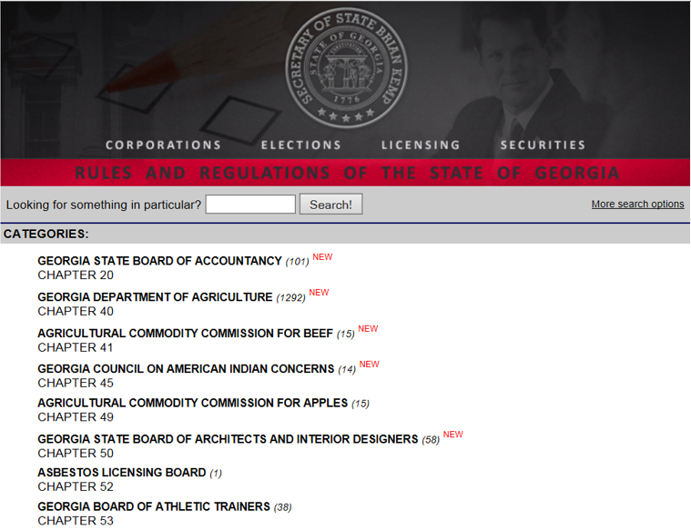
Administrative Law – Type 1
(continued)
      Can be found at http://rules.sos.state.ga.us/cgi-bin/page.cgi

Slide 5
Administrative Law – Type 1
(continued)
      The Rules and Regulations are indexed by the various administrative agencies or boards that have authority over the particular area of law
        Examples include rules of: the Georgia Dept. of Education, Dept. of Transportation, etc.
      Administrative decisions from State Agencies
        These are not published in any print compilation, but many are often available through the various agency websites

Slide 6
Case Law – Type 2
    Georgia has a three-level court system
      Trial courts
        Includes State and/or Superior Courts from each County
        Decisions by these courts are not published except for being filed as public record with their respective County’s clerk’s office
      Georgia Court of Appeals
        This is Georgia’s intermediate appellate court
        Decisions are published in the Georgia Appeals Report and by Westlaw, LexisNexis, Fastcase, etc. for their subscribers

Slide 7
Case Law – Type 2
(continued)
      Georgia Supreme Court
        Georgia’s highest appellate court
        Often the court of “last resort” for cases appealed from the Georgia Court of Appeals, although there are a number of cases that go directly to the Georgia Supreme Court due to their exclusive jurisdiction over certain matters
        Decisions are published in the Georgia Reports and by Westlaw, LexisNexis, Fastcase, etc. for their subscribers

Slide 8
Statutory Law – Type 3
    State laws are enacted by the Georgia General Assembly and are initially published as “session laws”
    Those laws are then compiled into the “Code”
    Georgia’s official Code is called the Official Code of Georgia Annotated
      “Annotated” simply means that the official code contains summaries of relevant decisions from the State’s appellate courts that are relevant to the particular code sections

Slide 9
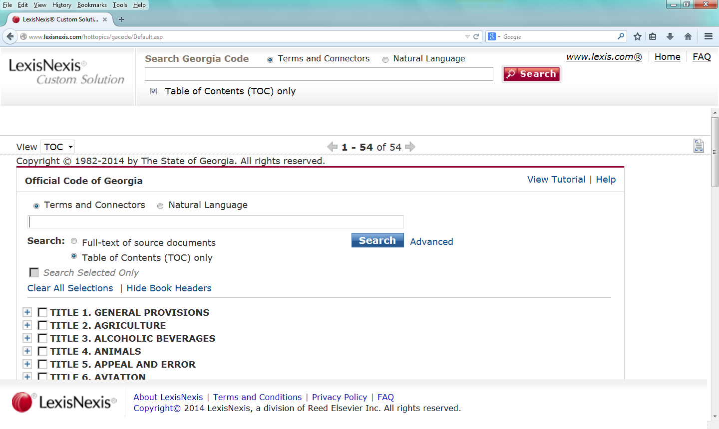
Statutory Law – Type 3
(continued)
    An unannotated version of the official code is available to the public on the Georgia General Assembly’s website
    http://www.lexisnexis.com/hottopics/gacode/Default.asp

Slide 10
The Official Code of Georgia Annotated
  How is it arranged?
    United States Constitution
    Georgia Constitution
    Georgia Code
    State and Local Court rules

Slide 11
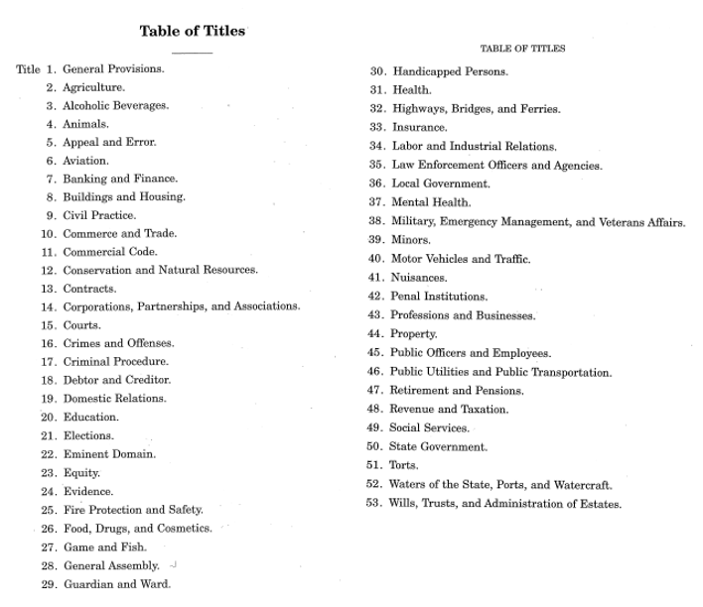
The Official Code of Georgia Annotated
(continued)
  The Georgia Code
    The Code is made up of a total of 53 “Titles”

Slide 12
The Official Code of Georgia Annotated
(continued)
    The Code is arranged alphabetically based on topics. For example:
      Title 9 is Civil Practice
      Title 15 is Courts
      Title 17 is Criminal Procedure
      Title 44 is Property

Slide 13
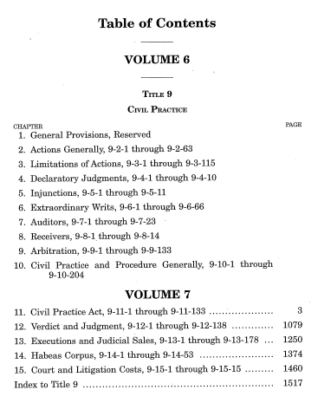
The Official Code of Georgia Annotated
(continued)
  Within each title are “Chapters”

Slide 14
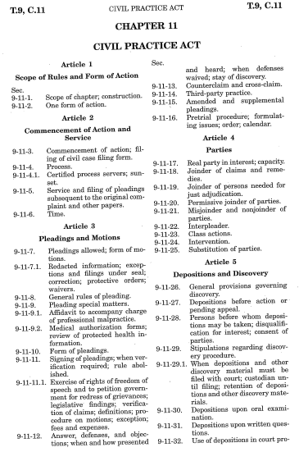
The Official Code of Georgia Annotated
(continued)
    Some chapters have “Articles” within each chapter

Slide 15
The Official Code of Georgia Annotated
(continued)
    We then get to a “Section” within each article or chapter that gives us our full citation
    Example: O.C.G.A. 9-11-26
      This would be found in Title 9, Chapter 11, Section 26

Slide 16
The Official Code of Georgia Annotated
(continued)

Slide 17
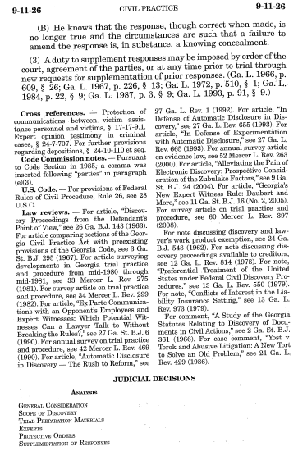
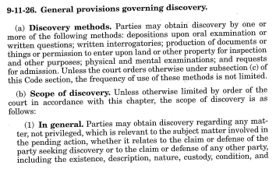
The Official Code of Georgia Annotated
(continued)

Slide 18
FYI!
  Provisions relating to Superior Court Clerks
    Title 15, Chapter 6, Article 2
    O.C.G.A. § 15-6-50 through O.C.G.A. § 15-6-100
    O.C.G.A. §§ 15-6-61 and 15-6-62 – Duties of Superior Court Clerks

Slide 19
The Official Code of Georgia Annotated
(continued)
    Using the Table of Contents at the beginning of each Title

Slide 20
The Official Code of Georgia Annotated
(continued)
    Using the Table of Contents at the beginning of each Chapter

Slide 21
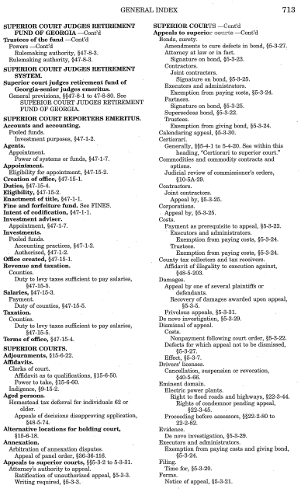
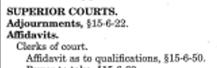
The Official Code of Georgia Annotated
(continued)
    Using the General Index
    Arranged alphabetically by topic, with subtopics arranged alphabetically under each general topic

Slide 22
Research Scenarios and Examples
Scenario 1
    A party comes to you wanting to file an appeal to the superior court of a denial of a rezoning by your local County Commission. The party has a question about whether he has to pay any costs for the appeal. How do you find the answer?

Slide 23
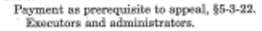
Research Scenarios and Examples
Scenario 1, continued

Slide 24
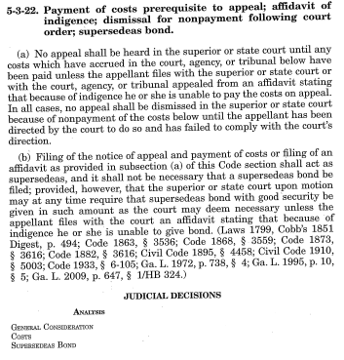
Research Scenarios and Examples
Scenario 1, continued

Slide 25
Research Scenarios and Examples
Scenario 2
    An attorney from the District Attorney’s office in another county calls your office and asks for certified copies of a number of criminal records involving a criminal case from a number of years back in your county. He explains that he needs these records for use in a criminal prosecution pending in his county. You quote him your normal fee for providing certified copies and he states that he is not required to pay for the copies. You’ve never heard this before. How do you find out whether this is true or not?

Slide 26
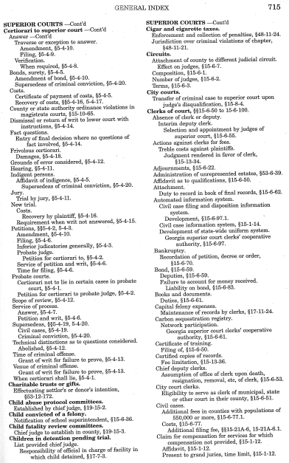
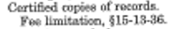
Research Scenarios and Examples
Scenario 2, continued

Slide 27
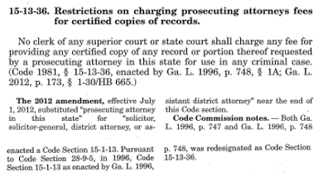
Research Scenarios and Examples
Scenario 2, continued

Slide 28
Research Scenarios and Examples
Scenario 3
    A party comes into your office with a deed transferring a property. He explains that he wants to transfer the property to an LLC that he is creating but that he has not yet submitted the paperwork to the State of Georgia to create the LLC. As such, he has left the name of the grantee blank and states that he will file another deed once the name of the LLC is established. This just doesn’t sound right but he insists that he “does it all the time”. How do you find out if you can accept the deed for filing?

Slide 29
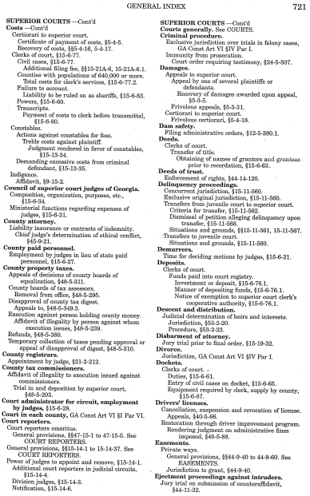
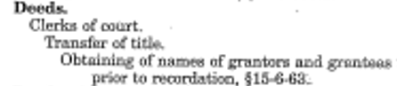
Research Scenarios and Examples
Scenario 3, continued

Slide 30
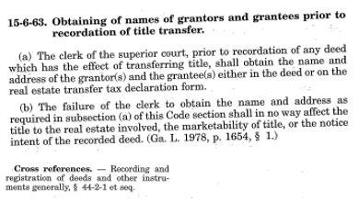
Research Scenarios and Examples
Scenario 3, continued

Slide 31
Research Scenarios and Examples
Scenario 4
  A young lady named Ana Rodriguez comes to your office and tells you she would like to become a notary public. She shows you her Green Card, and you see that she is 18 years old and a legal resident of the United States and lives in your county. You are not sure whether Ms. Rodriguez meets the qualifications for becoming a notary public under Georgia law. How will you find the statute that lists these qualifications?

Slide 32
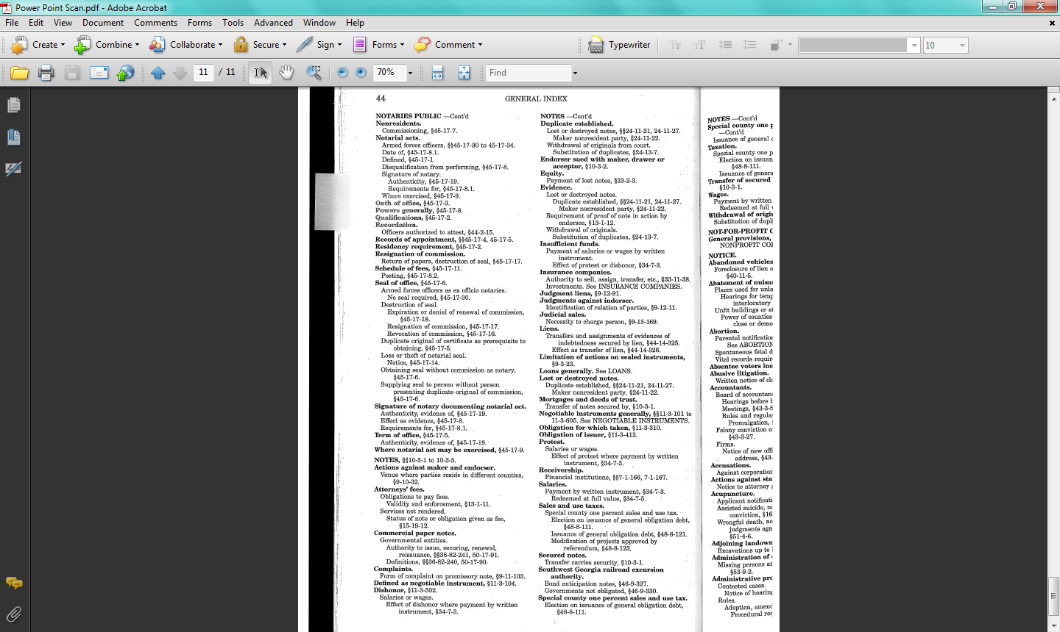
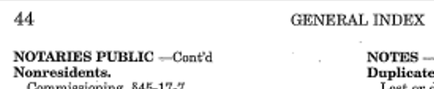
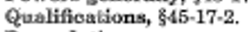
Research Scenarios and Examples
Scenario 4, continued

Slide 33
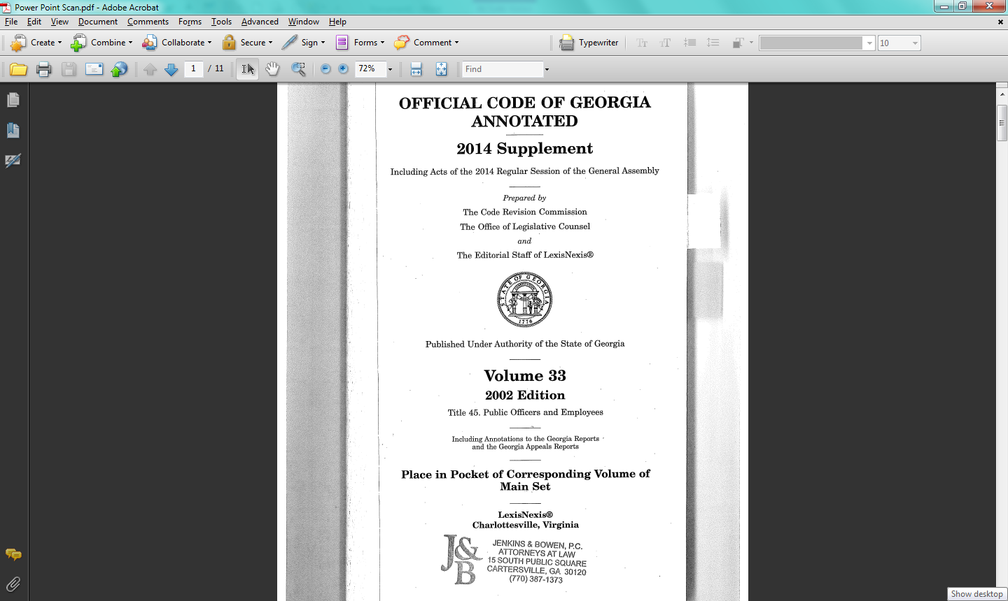
Research Scenarios and Examples
Scenario 4, continued

Slide 34
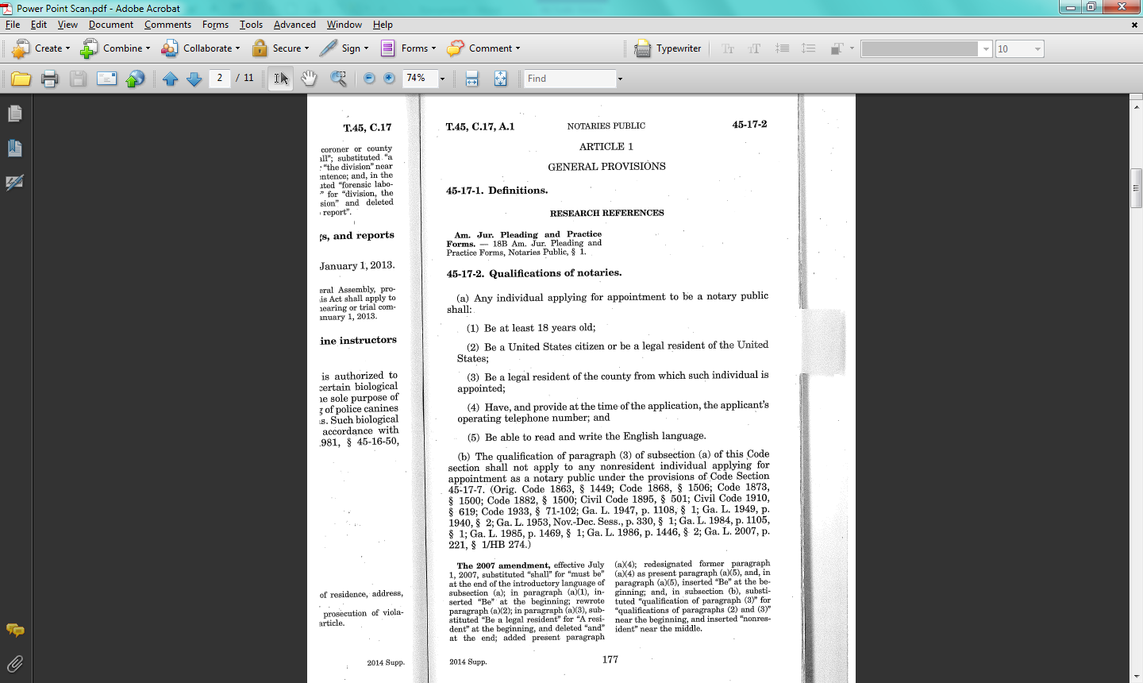
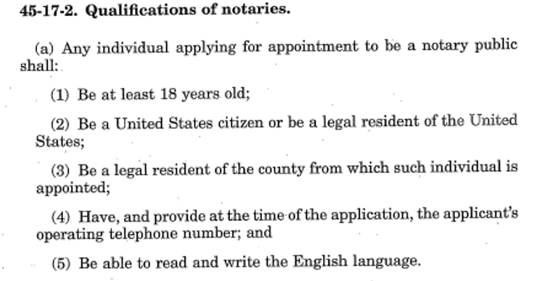
Research Scenarios and Examples
Scenario 4, continued

Slide 35
Research Scenarios and Examples -
Searching with Table of Contents :
Scenario 5
A woman named Angela Barnes comes into your office and asks you to record a deed for real property that she bought in a neighboring county. She explains that the property comes right up to the county line of your county. You do not think your office is the proper place to file the deed since the property is in the neighboring county, but Ms. Barnes insists that her brother, who is a lawyer, told her it was ok as long as the property touched the county line. Where would you look in the Georgia Code to find out where deeds should be recorded?

Slide 36
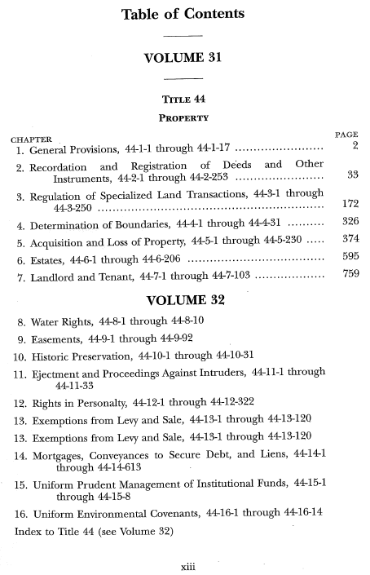
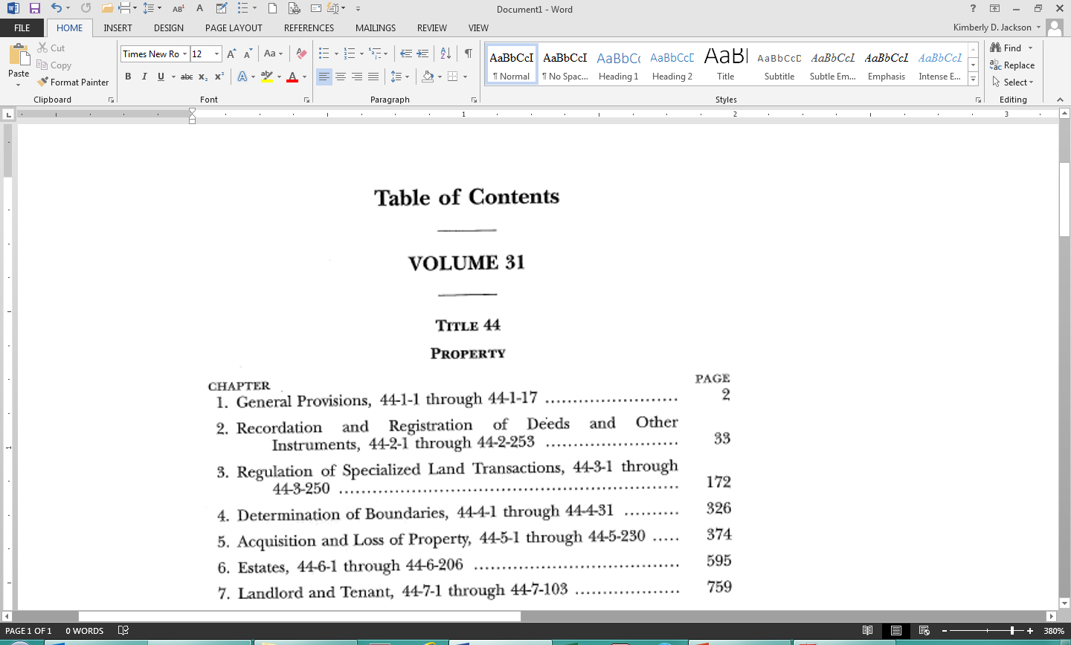
Research Scenarios and Examples -
Searching with Table of Contents :
Scenario 5, continued

Slide 37
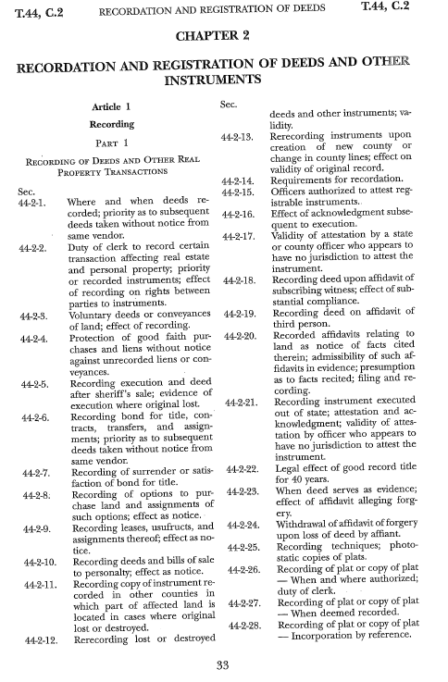
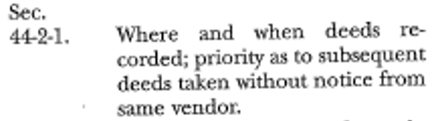
Research Scenarios and Examples -
Searching with Table of Contents :
Scenario 5, continued

Slide 38
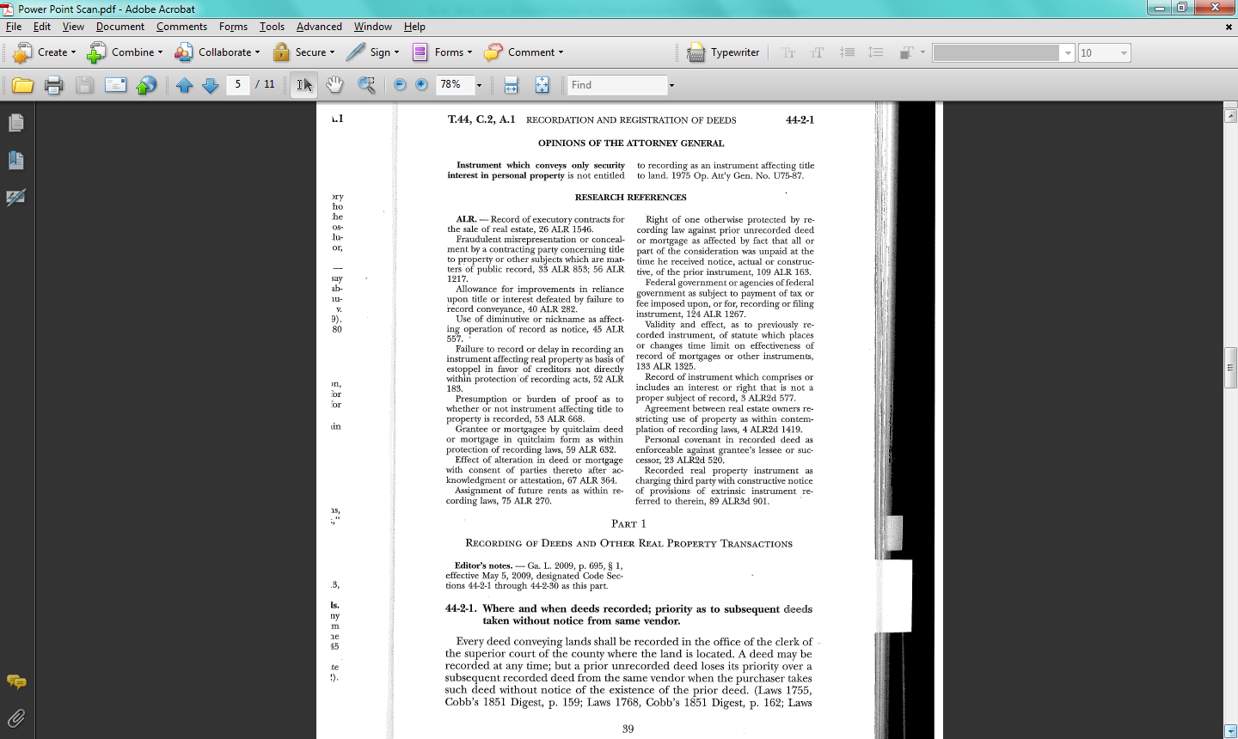
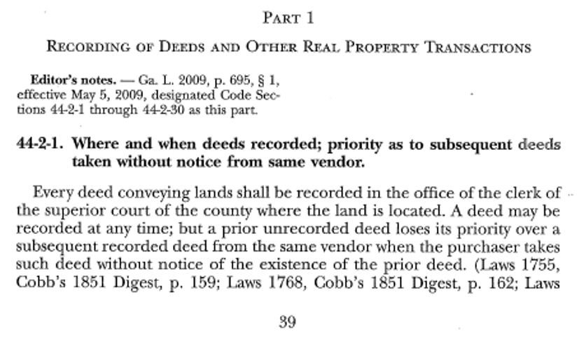
Research Scenarios and Examples -
Searching with Table of Contents :
Scenario 5, continued

Slide 39
Research Scenarios and Examples -
Searching with Table of Contents:
Scenario 6
  Pro se Plaintiff Williams comes to your office and asks you to give him a copy of his case file. When you tell him the fee for getting the records, he demands that you give him a copy of the file free of charge, and tells you that it is your duty under Georgia law to do so. You must find the Georgia Code section that lists the duties of a clerk of a superior court. You recall seeing something related to this in the Title of the Code dealing with “Courts” from a previous question that you’ve dealt with.

Slide 40
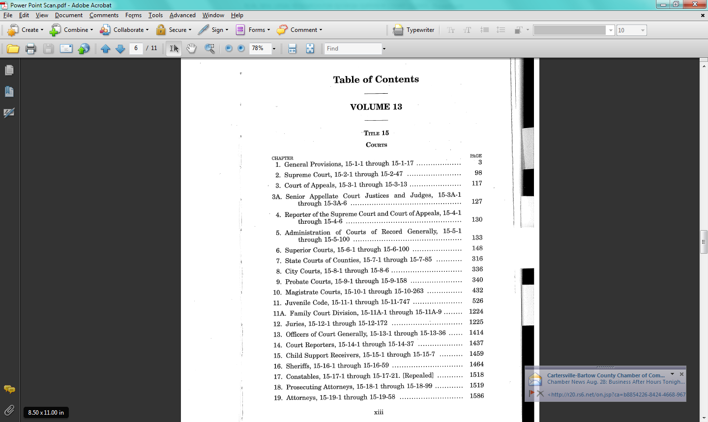
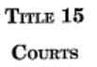
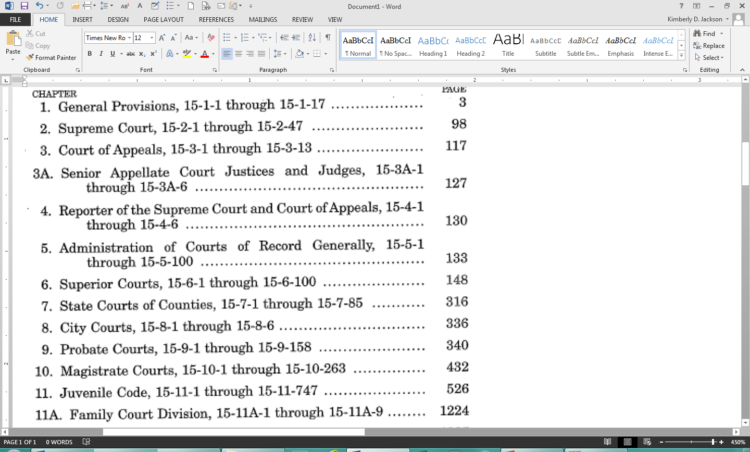
Research Scenarios and Examples -
Searching with Table of Contents :
Scenario 6, continued

Slide 41
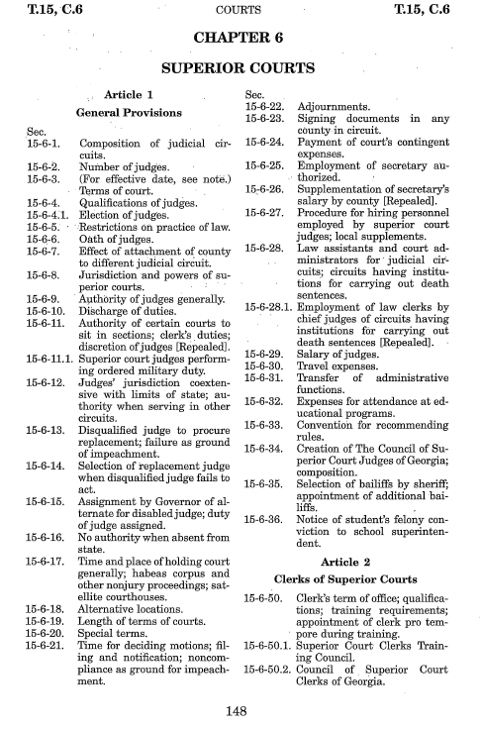
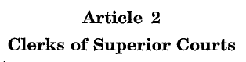
Research Scenarios and Examples -
Searching with Table of Contents :
Scenario 6, continued

Slide 42
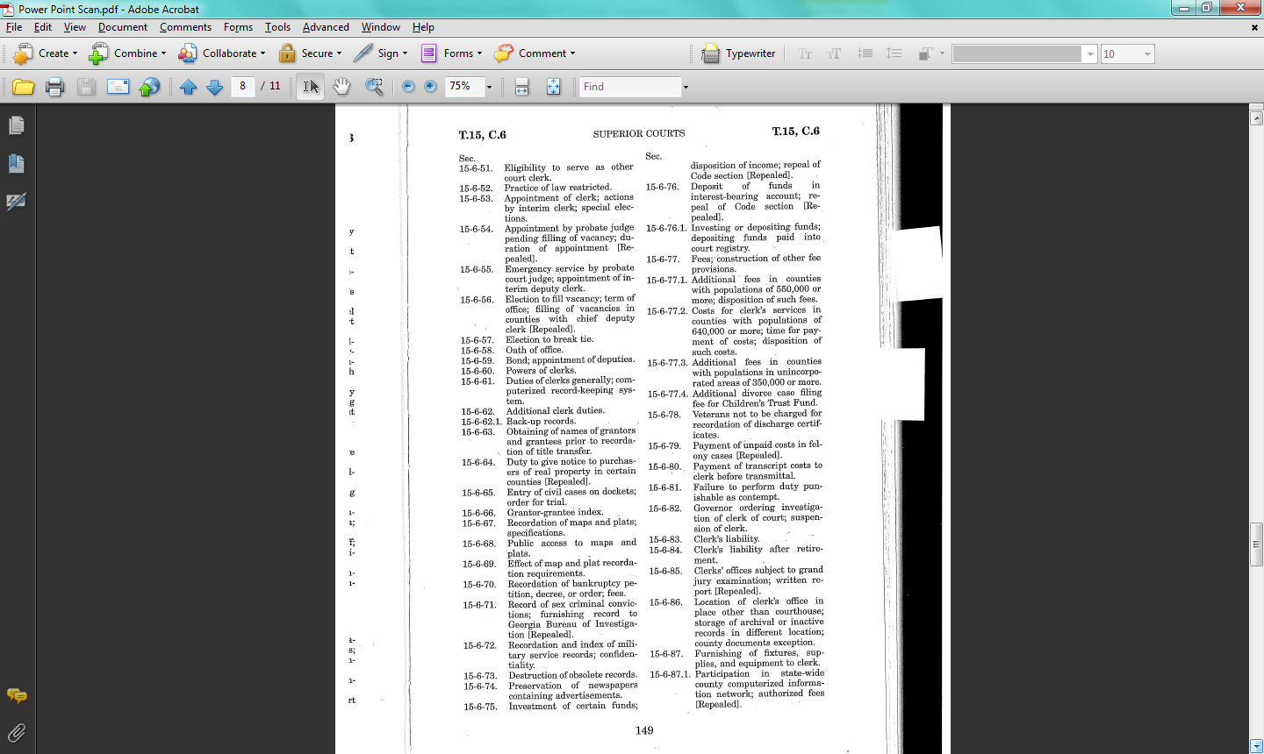
Research Scenarios and Examples -
Searching with Table of Contents :
Scenario 6, continued

Slide 43
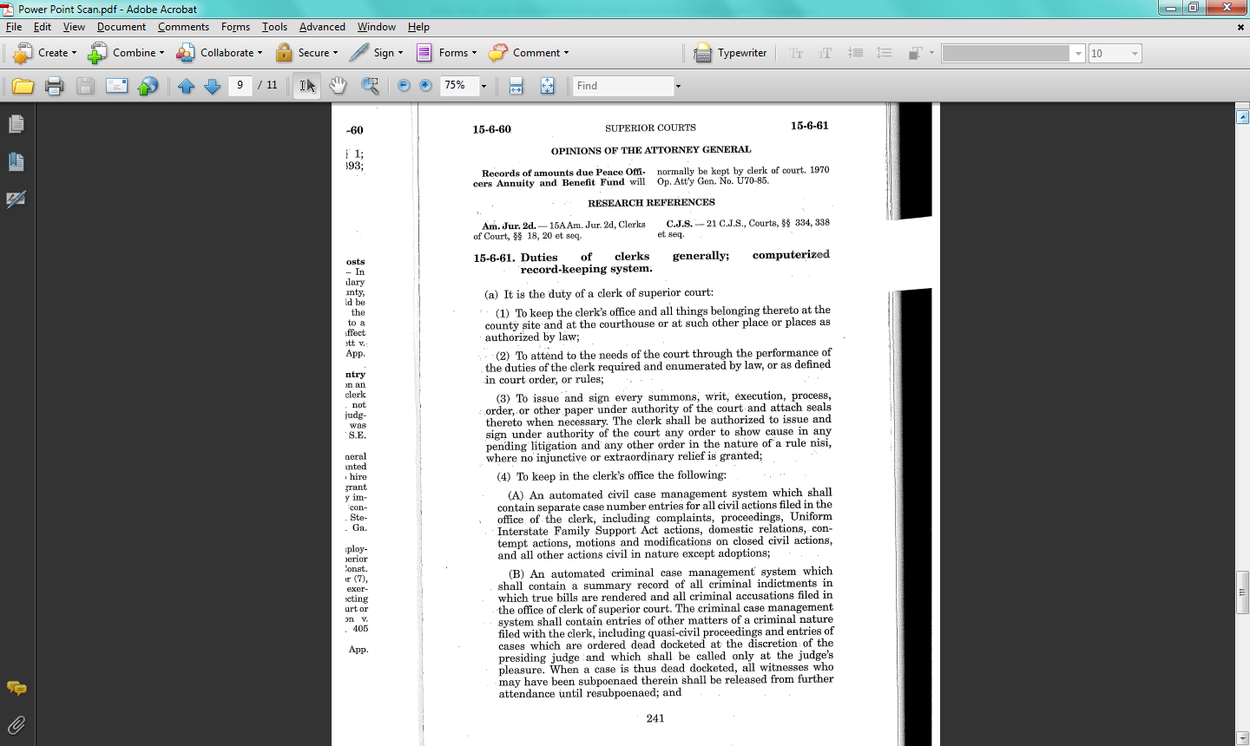
Research Scenarios and Examples -
Searching with Table of Contents :
Scenario 6, continued

Slide 44
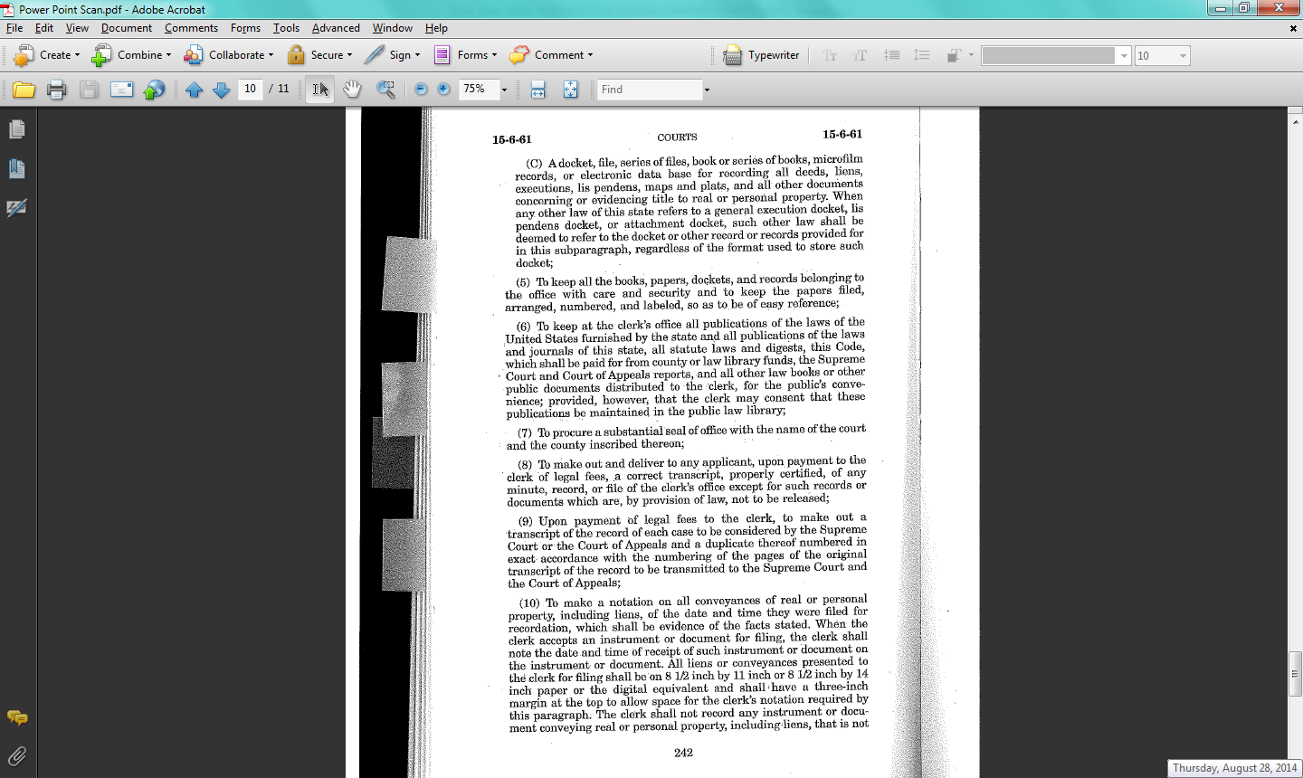
Research Scenarios and Examples -
Searching with Table of Contents :
Scenario 6, continued

Slide 45

The Official Code of Georgia (Unannotated)
  Available to the public on the Georgia General Assembly’s website at http://www.lexisnexis.com/hottopics/gacode/Default.asp

Slide 46
The Official Code of Georgia (Unannotated), continued
Three ways of finding things
  Browsing using the Table of Contents (TOC)
  Natural Language Search
  Terms and Connector Search

Slide 47
The Official Code of Georgia (Unannotated), continued
Table of Contents
  To expand a selection within a particular title, chapter or article, click the “+” beside the desired title, chapter or article
  To minimize a selection with a particular title, chapter or article, click the “-” beside the desired title, chapter or article
  Once you’ve located the Code section that you would like to see, click on the desired code section to open the text of that particular section

Slide 48
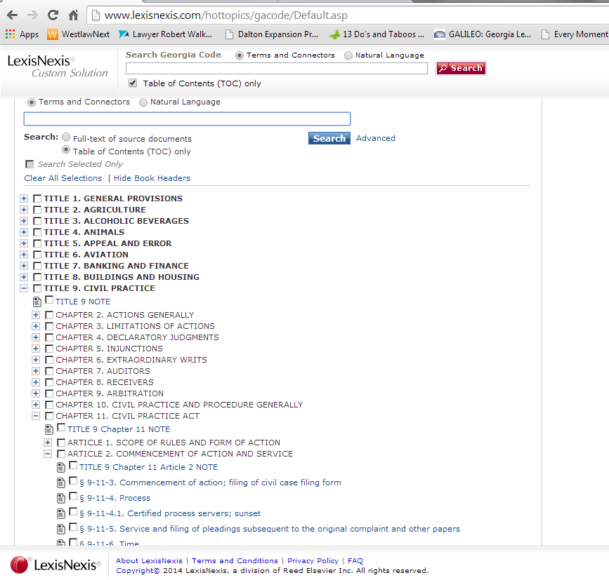
Table of Contents
The Official Code of Georgia (Unannotated), continued

Slide 49
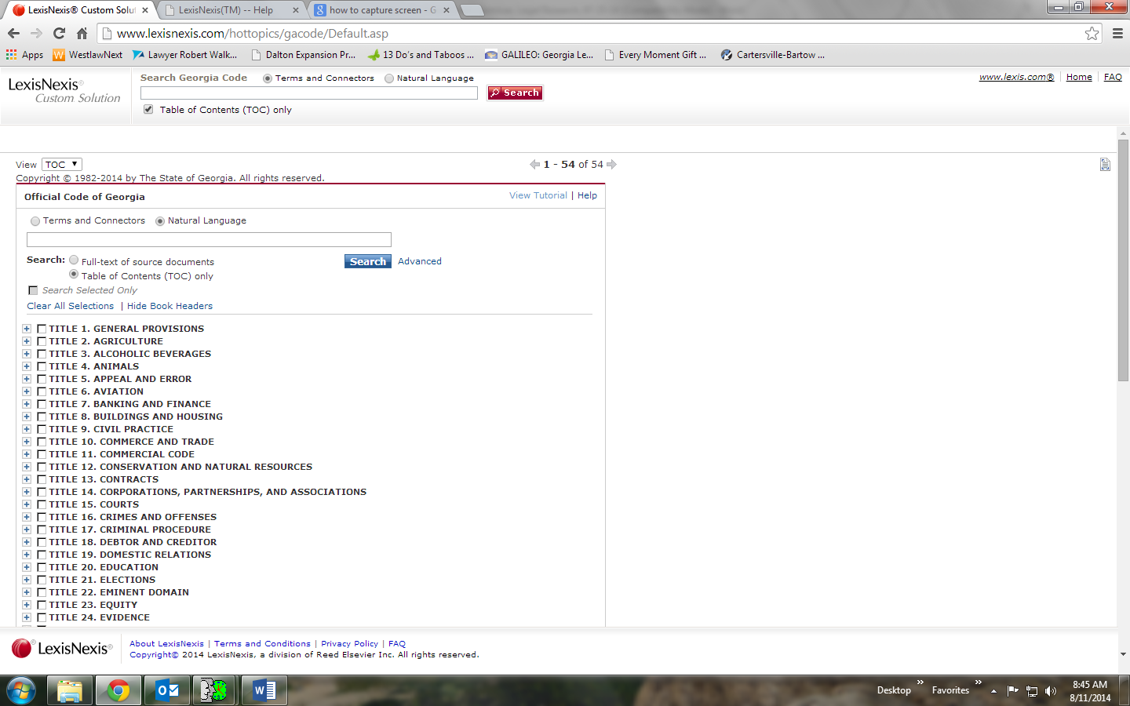
The Official Code of Georgia (Unannotated), continued
Natural Language Search

Slide 50
The Official Code of Georgia (Unannotated), continued
Natural Language, cont’d
    Lets you enter a search in plain English, without having to use any special terms
    Best suited for when you
      Need to research general or conceptual issues, rather than very specific topics
      Don't know much about an issue except for a few basic terms
      Don't feel comfortable writing Terms and Connectors (Boolean) search requests
      Want to supplement a Terms and Connectors search to ensure thorough results

Slide 51
The Official Code of Georgia (Unannotated), continued
  Developing a Natural Language Search
    Use words that you might use in describing your topic to another person
    Can use quotation marks to narrow search. For example,
      Searching default judgment will produce all code sections with the word default or judgment in them
      Searching “default judgment”, however, will only produce those code sections with the term “default judgment” in it

Slide 52
The Official Code of Georgia (Unannotated), continued
  Developing a Natural Language Search, cont’d.
    Example: To find code sections about opening default in a civil case you might search “what is necessary to open default in a civil case”

Slide 53
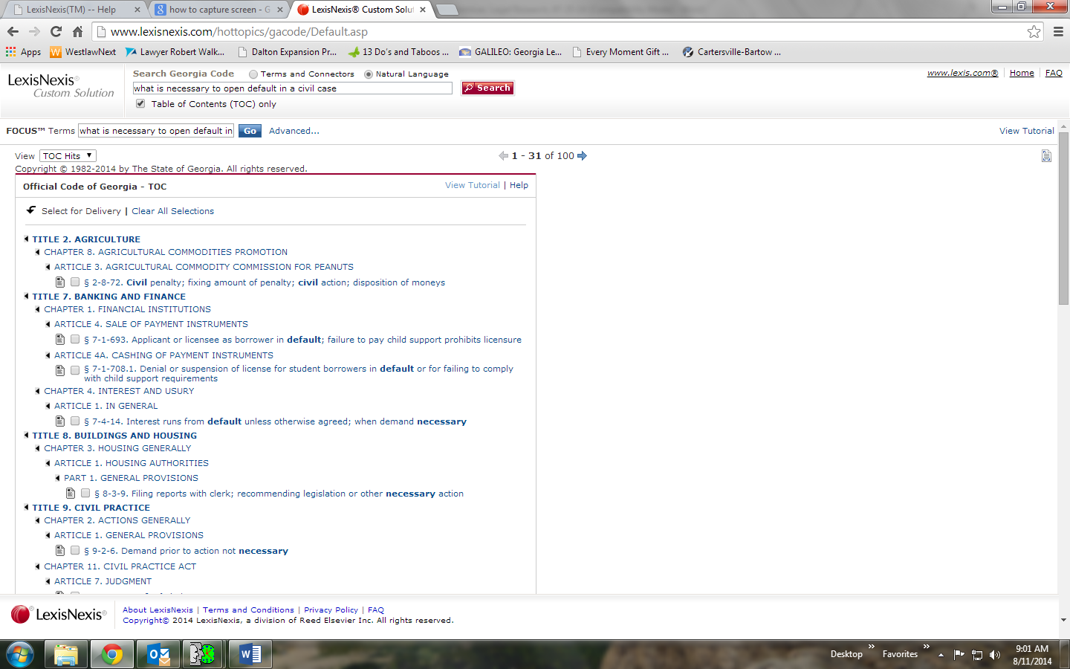
The Official Code of Georgia (Unannotated), continued
  Developing a Natural Language Search, cont’d.

Slide 54
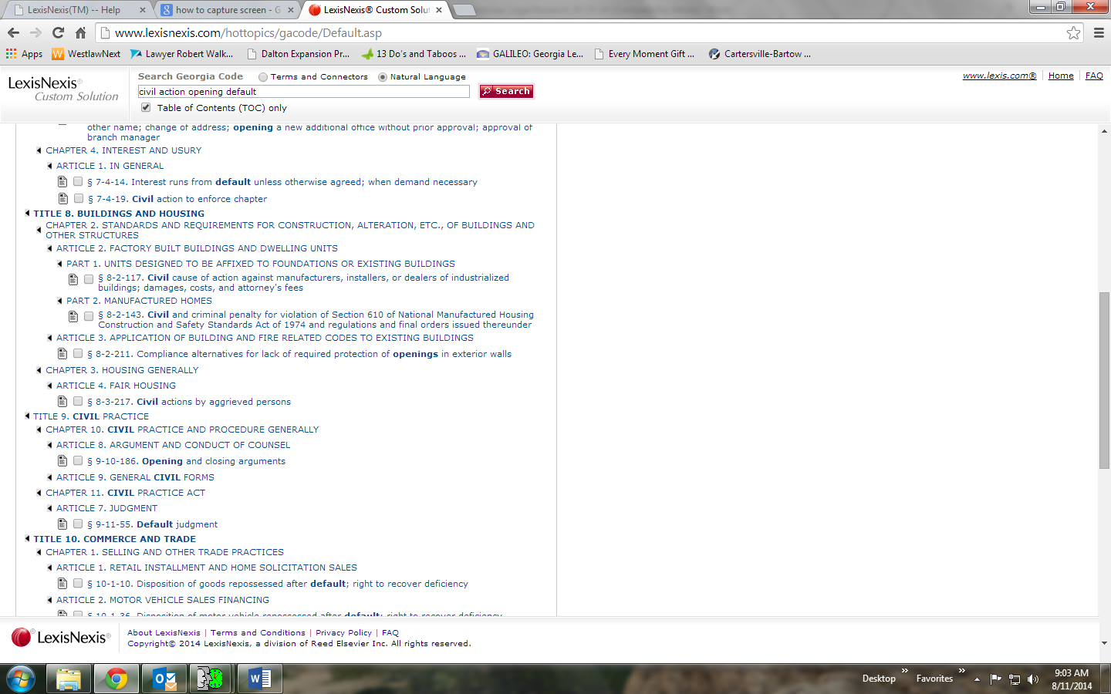
The Official Code of Georgia (Unannotated), continued
  Developing a Natural Language Search, cont’d.
    You may also use just the most important words and phrases (in any order). Example: “civil action opening default”

Slide 55
The Official Code of Georgia (Unannotated), continued
Advanced Natural Language Search

Slide 56
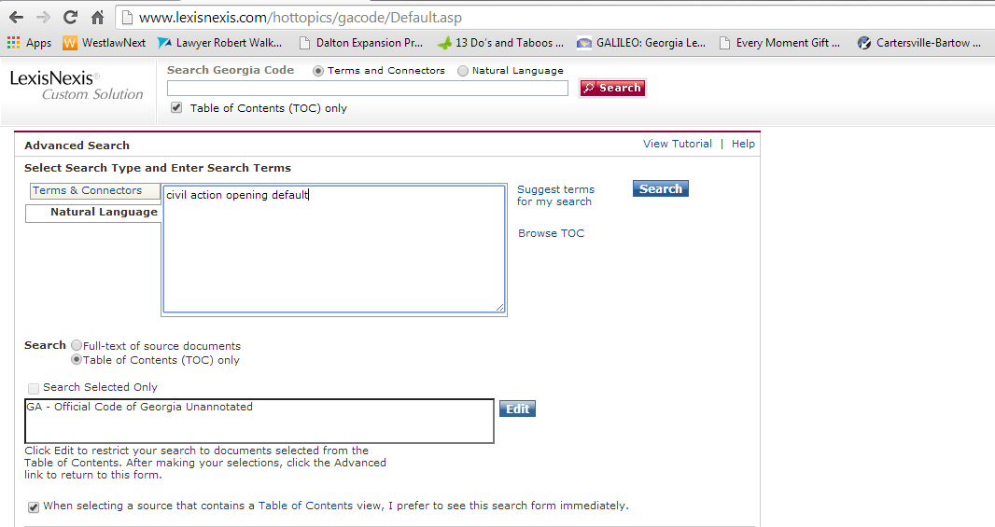
The Official Code of Georgia (Unannotated), continued
Advanced Natural Language Search, cont’d

Slide 57
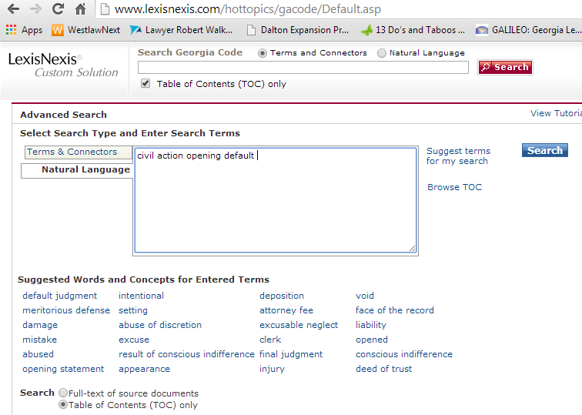
The Official Code of Georgia (Unannotated), continued
Advanced Natural Language Search, cont’d
  The “Suggest Terms for My Search” feature can help provide additional search terms to add to your search or replace terms used in your search
                RESULTS:

Slide 58
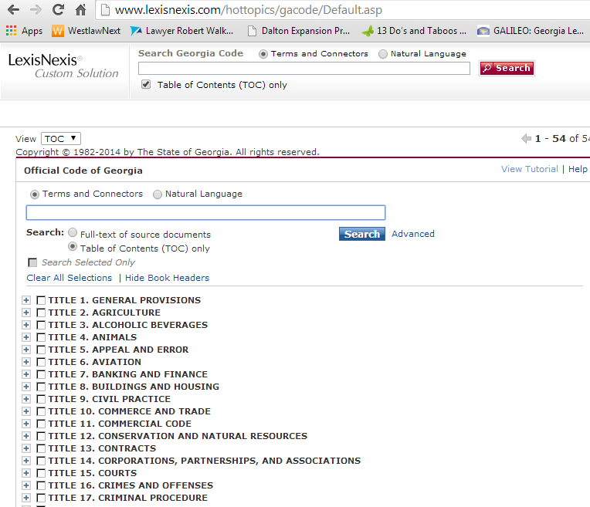
The Official Code of Georgia (Unannotated), continued
Terms and Connectors Search

Slide 59
The Official Code of Georgia (Unannotated), continued
  Terms and Connectors Search Cont’d.
    Lets you enter a search using “terms” and “connectors” to achieve the most accurate search results possible
    Best suited for when you
      Need to research very specific topics
      Need more narrowly tailored results than those produced by a Natural Language search
      Want to supplement a Natural Language search to ensure thorough results

Slide 60
The Official Code of Georgia (Unannotated), continued
  Developing a Terms and Connectors Search – Step One
    Determine the area that you want to research
    Example: Information about opening default by paying costs in a civil action

Slide 61
The Official Code of Georgia (Unannotated), continued
  Developing a Terms and Connectors Search – Step Two
    Choose your search terms
    Use terms that reflect ideas essential to your research topic. Include alternative terms, and avoid terms that are too general.
    For example: to find code sections on opening default by paying costs in a civil action you might use the following terms:
      default open pay costs civil

Slide 62
The Official Code of Georgia (Unannotated), continued
  Developing a Terms and Connectors Search – Step Three
    Use truncation and wildcards to include term variations
    Examples
      The “!” symbol finds a root word plus all the words made by adding letters to the end of it.
        For example, if you search default! it will yield the terms “default”, “defaulting” and “defaulted”

Slide 63
The Official Code of Georgia (Unannotated), continued
  Developing a Terms and Connectors Search – Step Three Cont’d.
    Examples Cont’d.
      The * symbol holds one space for a character at any point in a term
        For example, if you search default** it will yield results with the terms “default” and “defaulted”, but not “defaulting”
        The * can also be used in the middle of a word
          For example, if you search wom*n it will yield results with the terms “woman” and “women”

Slide 64
The Official Code of Georgia (Unannotated), continued
  Developing a Terms and Connectors Search – Step Four
    Link the search terms using connectors
    The Five Basic Connectors
      “OR” – Most commonly used when you want to search for synonyms or alternative terms of a word. For example: car OR auto OR vehicle OR automobile OR truck
      “AND” – Most commonly used when you want to find two or more terms in a document. For example: default AND judgment AND costs

Slide 65
The Official Code of Georgia (Unannotated), continued
    The Five Basic Connectors Cont’d.
      “w/#” – Used to find terms within a certain proximity to one another. For example, searching “default w/5 judgment” would produce all results where the words “default” and “judgment appear within 5 words to the right or left of one another
      “w/s” – Used to find terms within the same sentence. For example, searching “default w/s judgment” would produce all results where the words “default” and “judgment” appear within the same sentence in a document

Slide 66
The Official Code of Georgia (Unannotated), continued
      The Five Basic Connectors Cont’d.
      “w/p” – Used to find terms within the same paragraph. For example, searching “default w/p judgment” would produce all results where the words “default” and “judgment” appear within the same paragraph in a document

Slide 67
The Official Code of Georgia (Unannotated), continued
    Other connectors
      “ANDNOT” – Use to find documents in which a certain term does not appear. This must be used at the end of a search as all terms following it will be excluded from the search results. For example, searching “default AND judgment ANDNOT criminal” would produce all results where the words “default” and “judgment” appear, but would exclude any results where the word “criminal” appears

Slide 68
The Official Code of Georgia (Unannotated), continued
    Other connectors, cont’d
      “AT LEAST” – Use to require that a term or terms appear ‘at least’ so many times in a document. Use ATLEAST when you want only documents that contain an in-depth discussion on a topic rather than just a mention. For example, searching “ATLEAST3 (default and judgment)” would produce all results where the words “default” and “judgment” appear at least 3 times in a document

Slide 69
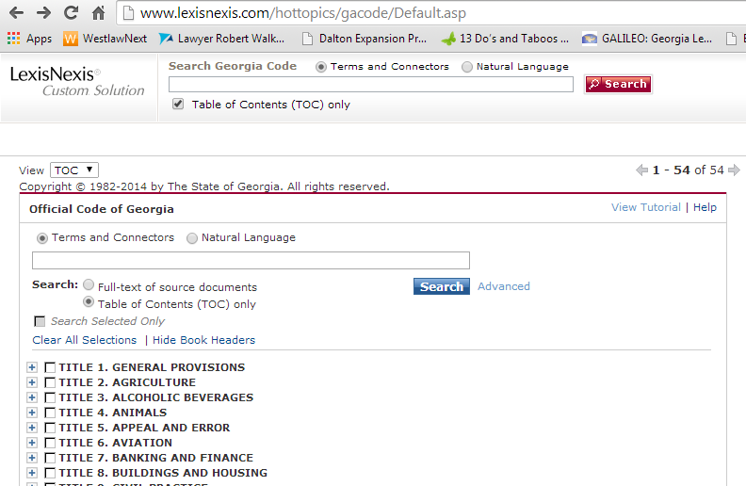
The Official Code of Georgia (Unannotated), continued
  Advanced Terms and Connectors Search

Slide 70
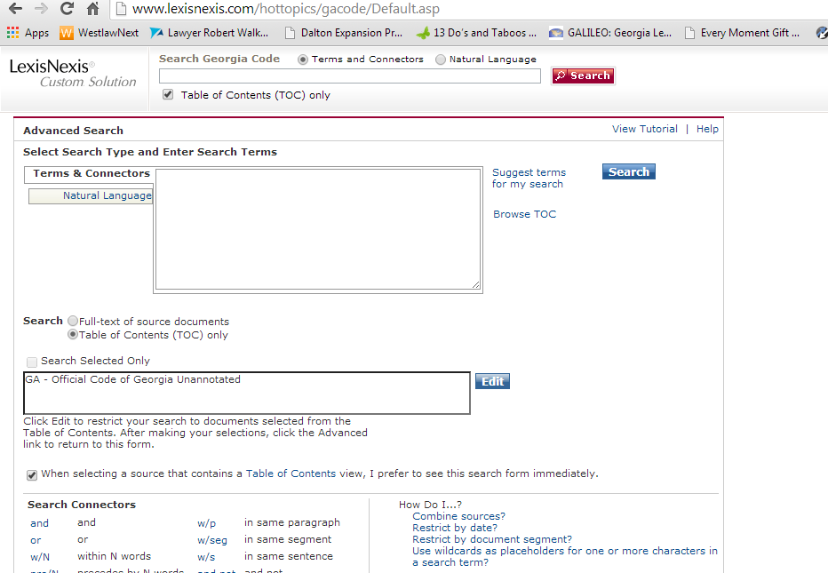
The Official Code of Georgia (Unannotated), continued
  Advanced Terms and Connectors Search, cont’d

Slide 71
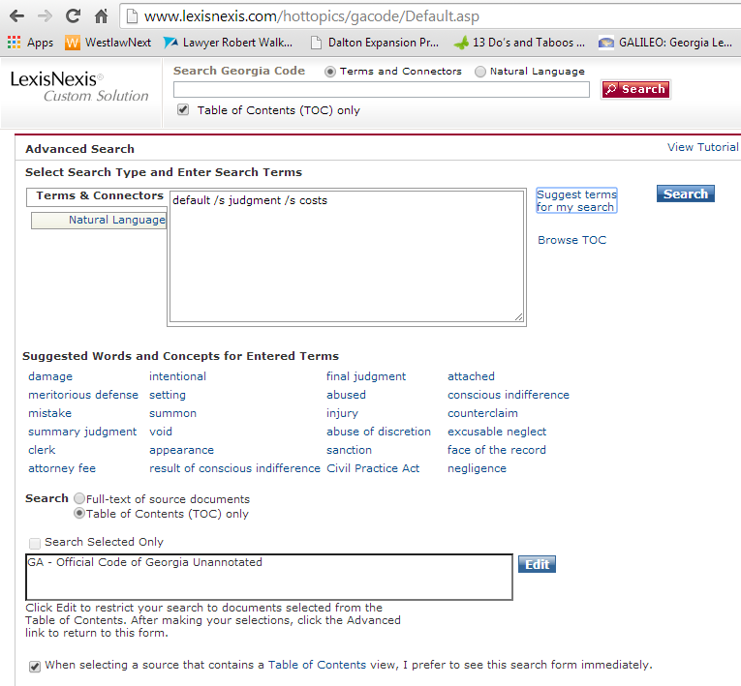
The Official Code of Georgia (Unannotated), continued
  Advanced Terms and Connectors Search, cont’d
    The “Suggest Terms for My Search” feature can help provide additional search terms to add to your search or replace terms used in your search

Slide 72
Research Scenarios and Examples
Scenario 1
  An intern from a nearby law firm comes to your office with a witness subpoena and asks you to issue it. You are not sure if the subpoena meets all the requirements under Georgia law, and you just ran out of the blank subpoenas that you usually keep on your desk. How would you find the Georgia Code provision that sets out the form of a subpoena?

Slide 73
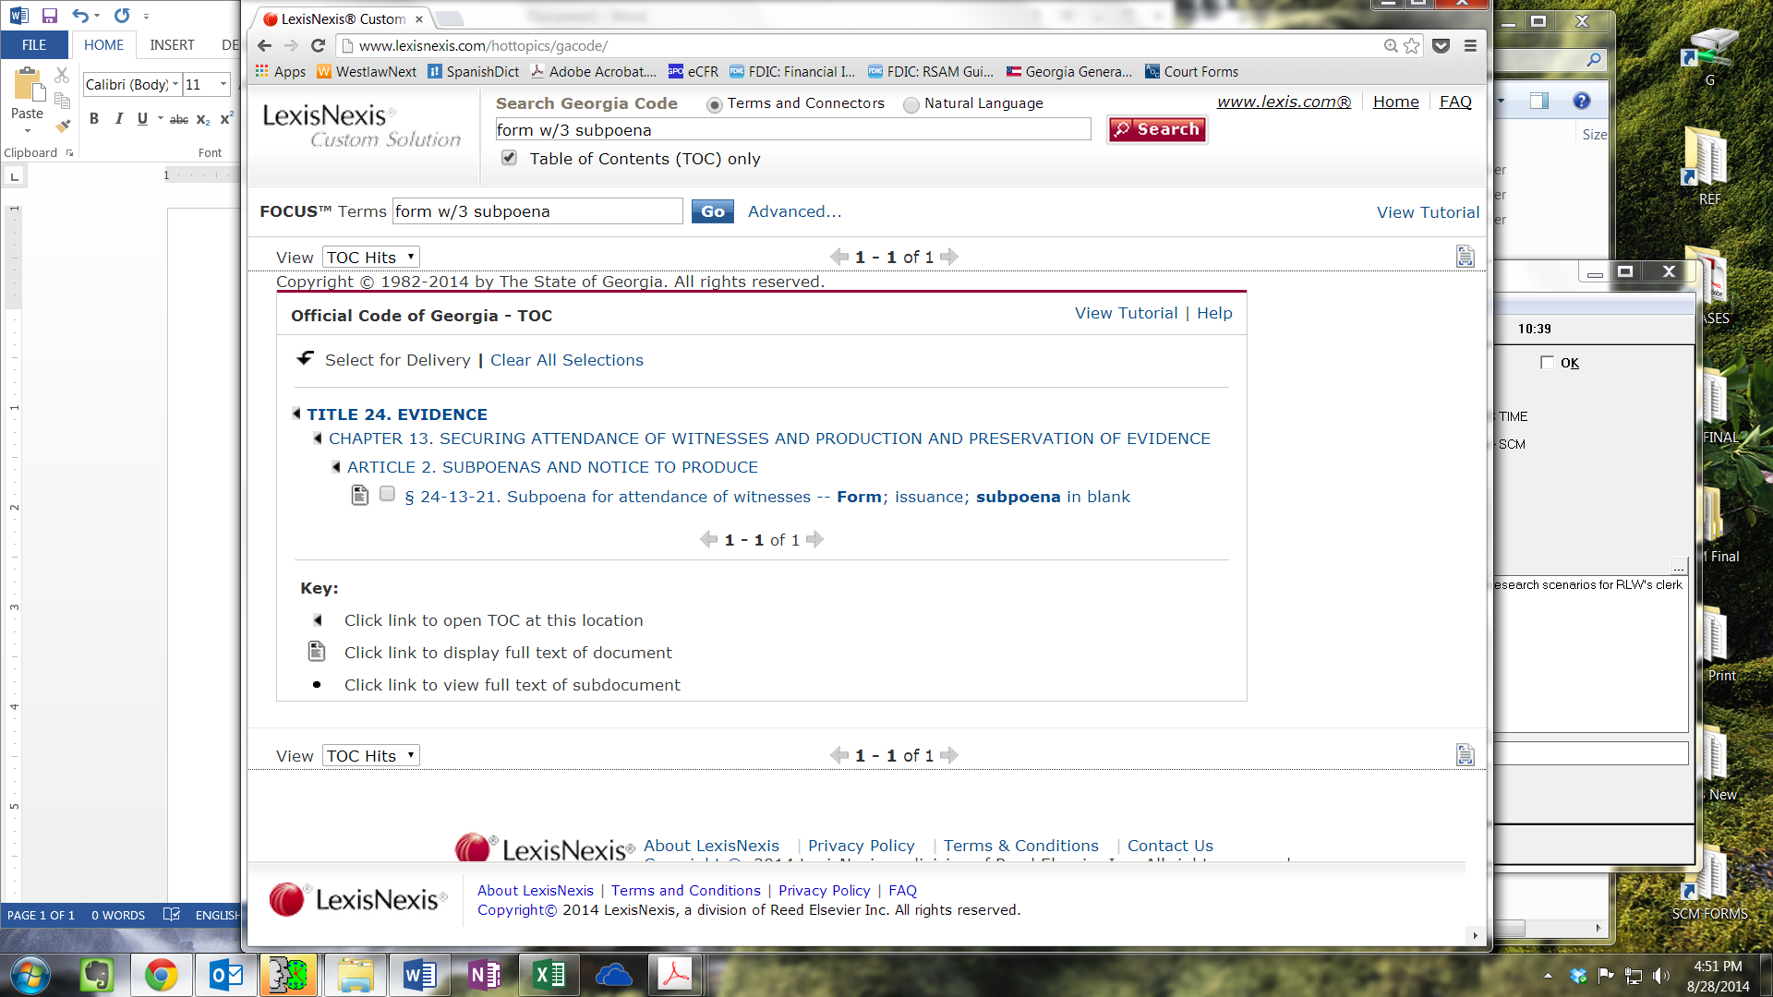
Research Scenarios and Examples
Scenario 1, continued
    Search Terms and Connectors --> Table of Contents (TOC) only --> Form w/3 subpoena

Slide 74
Research Scenarios and Examples
Scenario 1, continued
    The only result is OCGA § 24-13-21.

Slide 75
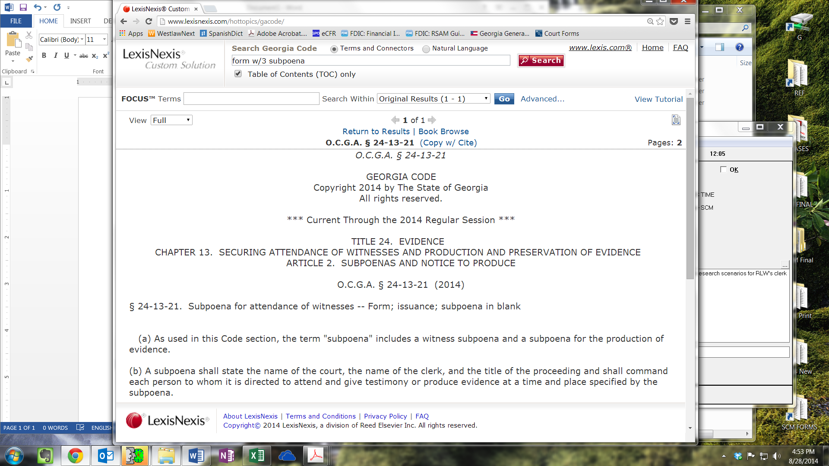
Research Scenarios and Examples
Scenario 1, continued
    Subsection (b) lists the requirements for a subpoena

Slide 76
Research Scenarios and Examples
Scenario 2
  You receive an Open Records Request pursuant to OCGA § 50-18-72 requesting all military discharge records relating to Jack Smith, a former resident of your county who has been deceased for more than ten years. You find the records, and see that they were filed more than thirty years ago. However, you see that Jack Smith was dishonorably discharged, and you have some concerns about whether you may release the records to the public. What search would you use to find out if there is any statute dealing specifically with military records?

Slide 77
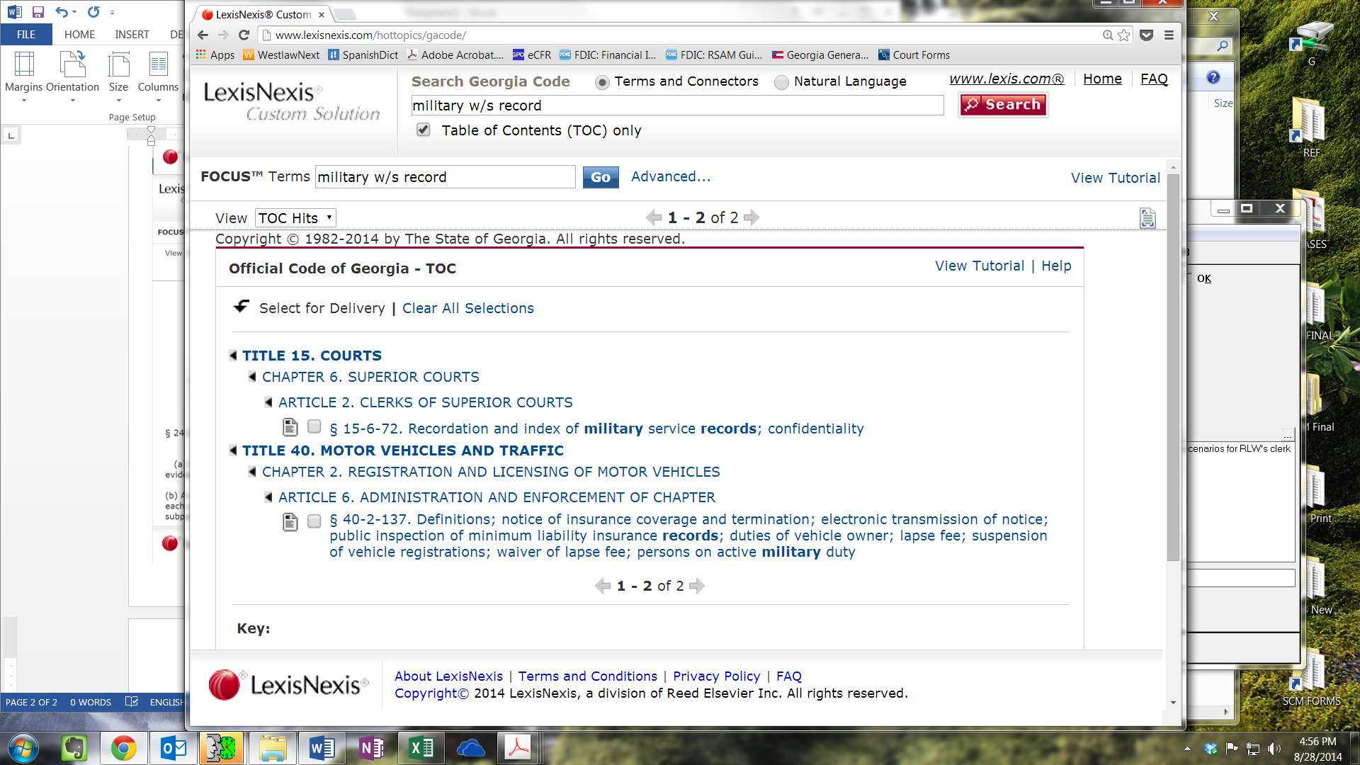
Research Scenarios and Examples
Scenario 2, continued
    Terms and Connectors → Table of Contents (TOC) only → Military w/s record

Slide 78
Research Scenarios and Examples
Scenario 2, continued
    The search produces two results. The one that looks most applicable is OCGA § 15-6-72. Recordation and index of military service records; confidentiality

Slide 79

Research Scenarios and Examples
Scenario 2, continued
    Subsection (c)(1) talks about the confidentiality of military service records

Slide 80

Research Scenarios and Examples
Scenario 2, continued
    If you searched military w/5 record the search would only produce one result - OCGA § 15-6-72 – which is the statute that you are looking for

Slide 81
Research Scenarios and Examples
Scenario 3
  Attorney Smith files a notice of appeal, which designates certain motions that were filed during the case to be omitted from the record on appeal. As you are preparing the record for appeal, Attorney Smith calls your office to ask whether you will leave the designated motions out of the record on appeal. You are not sure whether it is permissible under Georgia law to omit certain items from the record for an appeal. You must find the statute dealing with the preparation of the record on appeal by the court clerk in order to answer Attorney Smith’s question.

Slide 82
Research Scenarios and Examples
Scenario 3, continued
    Search Terms and Connectors → Table of Contents (TOC) only → record w/s appeal
    This search brings up several results. Rather than looking through each of them, search FOCUS Terms for “clerk” to see if any specifically deal with the clerk’s role

Slide 83

Research Scenarios and Examples
Scenario 3, continued

Slide 84
Research Scenarios and Examples
Scenario 3, continued
    The only result is OCGA § 5-6-43. Preparation and transmittal of record on appeal by court clerk; retention of copy by clerk; furnishing at no cost to Attorney General in capital cases; notification where defendant confined to jail
      Subsection (a) directs the clerk to omit the things designated for omission by the appellant and not designated for inclusion by the appellee

Slide 85
Research Scenarios and Examples
Scenario 4
  A Complaint is filed in your court and Defendant Walker is properly served with process. After thirty days have passed, Defendant Walker has not filed an Answer, so you mark the case in default. Five days later, Lawyer Johnson comes to your office and says she has just been retained by Defendant Walker. Lawyer Johnson files an Answer on behalf of Defendant Walker and asks you to mark the case as no longer in default because she has filed an Answer within 15 days of the case becoming in default, and is therefore entitled to open the default as a matter of right. How would you find the statute dealing with opening default as a matter of right to make sure Lawyer Johnson has met all the requirements?

Slide 86
Research Scenarios and Examples
Scenario 4, continued
    If you search open w/s default w/s right in the Table of Contents (TOC) your search produces no result
    Your next step would be to go back and change your search from “Table of Contents (TOC) only” to “Full-text of source documents”
    This is because often the titles of the code sections don’t reflect everything that is written in the code section

Slide 87

Research Scenarios and Examples
Scenario 4, continued
    Select "Edit Search" to go back and change your search

Slide 88

Research Scenarios and Examples
Scenario 4, continued
    Select “Full text of source documents” → and search open w/s default w/s right

Slide 89
Research Scenarios and Examples
Scenario 4, continued
    The only result is the one you want.
    OCGA § 9-11-55. Default Judgment.
      “The default may be opened as a matter of right . . . upon the payment of costs.”

Slide 90
Research Scenarios and Examples -
Narrowing Your Search Results:
Scenario 5
  A local lawyer who you know well comes to your office and asks you to issue a summons for a case that has not been filed yet. He explains that he plans to file the Complaint first thing the next morning, but he needs the Summons today so he can make sure the Defendant is served soon after the Complaint is filed. You trust the lawyer to keep his word, but you do not know whether you are authorized under Georgia law to issue a summons for a case that has not been filed. What search would you run to find the statute in the Civil Practice Act dealing with the issuance of a summons?

Slide 91

Research Scenarios and Examples -
Narrowing Your Search Results:
Scenario 5, continued
    Begin by narrowing your search to the Civil Practice Act by checking the box next to Chapter 11 of Title 9

Slide 92
Research Scenarios and Examples -
Narrowing Your Search Results:
Scenario 5, continued
    A TOC search for Issue and summons returns no results, and therefore it is necessary to broaden your search beyond the Table of Contents.

Slide 93

Research Scenarios and Examples -
Narrowing Your Search Results:
Scenario 5, continued
    Terms and Connectors → Select “Full-text of source documents → Issue w/s summons

Slide 94
Research Scenarios and Examples -
Narrowing Your Search Results:
Scenario 5, continued
    The only result that comes up is the one you want
    OCGA § 9-11-4. Process
      Subsection (a) provides that the clerk shall issue a summons upon the filing of the complaint

Slide 95
Research Scenarios and Examples -
Narrowing Your Search Results:
Scenario 6
  A lawyer comes to your office and explains that he is filing a complaint in a car accident case and tells you that he needs to serve an uninsured motorist carrier with a “second, duplicate original” of the complaint. You explain that if a party wanted an additional copy of the complaint you would typically ask that they provide the copy and that your office would stamp it. He insists that you must issue the second original of the complaint. You’re not sure what to do. How do you find the answer?

Slide 96
Research Scenarios and Examples -
Narrowing Your Search Results:
Scenario 6, continued
    Terms and Connectors → Table of Contents (TOC) only → second OR duplicate AND original AND complaint
    This search produces no results so you must edit the search and expand it from “Table of Contents (TOC) only” to “Full-text of source documents”

Slide 97
Research Scenarios and Examples -
Narrowing Your Search Results:
Scenario 6, continued
    This search produces 8 results
    You recall the lawyer mentioned he needed this to serve an “uninsured” motorist insurance carrier
    As such, what would happen if you add the term “uninsured” to the FOCUS terms, thereby searching for that term in the 8 results that were returned?

Slide 98

Research Scenarios and Examples -
Narrowing Your Search Results:
Scenario 6, continued

Slide 99
Research Scenarios and Examples -
Narrowing Your Search Results:
Scenario 6, continued
    One result would be produced – OCGA § 33-7-11
    Subsection (d) provides that “[i]n any case arising under this Code section where service upon an insurance company is prescribed, the clerk of the court in which the action is brought shall have such service accomplished by issuing a duplicate original copy for the sheriff or marshal to place his or her return of service in the same form and manner as prescribed by law for a party defendant.”

